Slide 1
STEPS IN DEMAND FORECASTING
NAME:G.SOWMYA
ROLL NO:22H51A0588

Slide 2
01 INTRODUCTION
03 EXPLANATION
02 STEPS INVOLVED
04 CONCLUSION
BUSINESS FIRM

Slide 3
INTRODUCTION
It is a technique for estimation of probable demand for a product or services in the future. It is based on the analysis of past demand for that product or service in the present market condition. Demand forecasting should be done on a scientific basis and facts and events related to forecasting should be considered.
Therefore, in simple words, we can say that after gathering information about various aspect of the market and demand based on the past, an attempt may be made to estimate future demand. This concept is called forecasting of demand.

Slide 4
01 STEPS INVOLVED

Slide 5
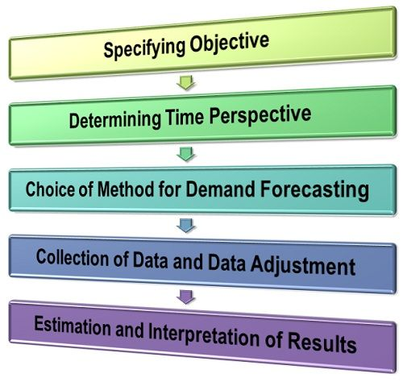
STEPS INVOLVED

Slide 6
03 explanation

Slide 7
explanation
Identifying objectives: In first step, the purpose or objectives for which the demand forecasting is to carried out should be clearly specified. The objective need to be well-defined in terms of short or long-term demand, firm’s market share, the whole market or only a segment of it for firm’s product etc. Proper specification of objective will provide a right direction to whole research.
Determining time perspective: The demand may be forecasted either for short period or long period depending upon the objectives of firm. In case of short-term demand forecasting that is for next 2 to 3 years, many determinants of demand do not change significantly and can be taken as constant. Whereas the demand determinants change significantly in case of long run forecasting. It is required to clearly specify the time perspective of forecasting to be done.

Slide 8
explanation
Choosing the forecasting method: Now a forecasting method is chosen once the objectives and time perspective is specified. There are different methods of demand forecasting which are categorized into 2 types: survey methods and statistical methods. In survey method, opinions polls and consumer survey methods are used. Whereas econometric, trend projection and barometric methods are used in statistical methods. Both of these method type differ from one another on the basis of type of data required, forecasting purpose, time frame of forecasting and availability of data. Only that method should be chosen which best suits the requirement.

Slide 9
explanation
Collection of data and data adjustment: Now the data required for doing forecasting is selected which can be primary or secondary data or even both. The first-hand data which is not collected before is termed as primary data. Whereas the data already collected in past by someone is known as secondary data. Sometimes the data is even adjusted or manipulated when the required set of data is not available. This is done to build consistency of data with the data required.
Interpretation of results: Now finally the demand is forecasted for predefined time period. It is done at last stage once the forecasting method is finalized and required set of data is collected. Usually, the equations are used for showing the estimates while results are interpreted in an easy and usable form.

Slide 10
04 conclusion

Slide 11
conclusion
In conclusion, demand forecasting is of paramount importance for businesses to effectively manage their operations and resources. By accurately predicting future demand, businesses can optimize inventory levels, production schedules, and resource allocation, leading to improved efficiency and cost savings. Additionally, demand forecasting helps businesses anticipate market trends, identify growth opportunities, and stay competitive in their industry. Overall, a well-executed demand forecasting process is essential for informed decision-making and strategic planning, enabling businesses to meet customer demands efficiently and maximize their profitability.

Slide 12

THANK YOU

